Slide 1

Lecture 6
-NLP is all about words, their arrangement and their meaning
-NLP is a branch of AI that tries to emulate/understand the way a human speaks to another human
-Lecture 6 is about Part-of-Speech tagging of each word in the sentence
(useful for understanding the overall meaning of the sentence)

Slide 2
Part-of-Speech (POS)
EIGHT popular Part-of-Speech (POS) [Ch. 5 of text]
Noun : Common noun (wolf, cat), Proper noun (Trump, Delhi)
Verb : ate, cried, eat, cry
Preposition : on, under, over, near, by, at, from, to, with (used with Noun Phrase (NP))
Pronoun : possessive (her, his, my) personal (he, me, I, you)
Conjunction : and , or , as, if , when
Adjective : slow, fast, beautiful
Determiner : article (a, an, the), this, that
Adverb : slowly, yesterday, there

Slide 3
Part-of-Speech (POS)-some other categories
Thrax (100 B.C.) - one of the earliest then came several classifications
Penn Treebank (45 POS classes) – Marcus et al. (1993)
Brown corpus (87 POS classes) - Francis, 1979
C7 (146 POS classes) – Garside et al., 1997
Some other POS classes (other than the EIGHT) & their examples:
Auxiliary verb (used along with main verb): can, may, should
Numerals: one, two,…

Slide 4
POS tagging of words in a sentence
POS Tagging: Associating the right POS with each word in the sentence
Each word may have multiple POS!
How to decide on the correct POS of a word?
- Two techniques that we will be covering later this semester: -
1) PCFG (Probabilistic CFGs)
2) HMM (Hidden Markov Model)

Slide 5
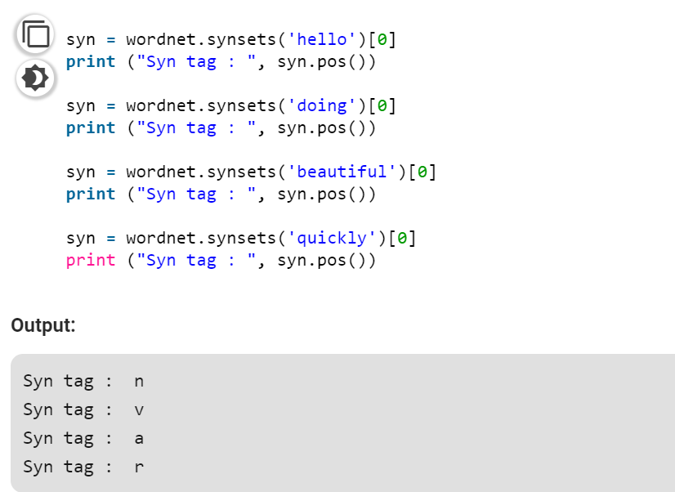
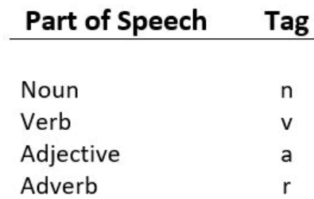
Programming
https://www.geeksforgeeks.org/nlp-synsets-for-a-word-in-wordnet/

Slide 6
Answer the programming Assignment of this week related to Lectures 6 and 7 in the link provided in MOODLE (by Tuesday 1st Sept’20 11 pm)

